Slide 1
SYSU
Attention and Transformers
Shangsong Liang
Notes:
https://cs.uwaterloo.ca/~mli/cs886-002-2020.html
https://zhuanlan.zhihu.com/p/48508221
Attention is all you need

Slide 2
02
Attention and Transformers
Plan
Basic models, related to transduction models and attention.
Encoder-Decoder model, using recurrent networks such as LSTM.
Attention and Transformers

Slide 3
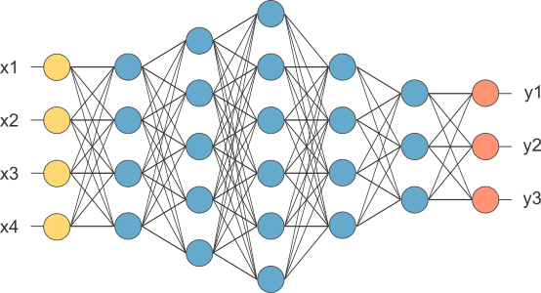
02
Attention and Transformers
1. Fully connected network, feedforward network
To learn the weights on
the edges

Slide 4
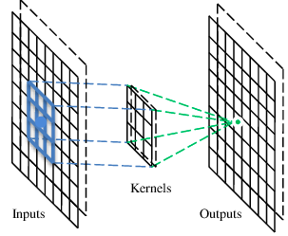
02
Attention and Transformers
2. CNN
A CNN is a neural network with some convolutional layers
(and some other layers). A convolutional layer has a number
of filters that do convolutional operation.
A filter

Slide 5
02
Attention and Transformers
These are the network parameters to be learned.
Convolutional layer
1 | -1 | -1
-1 | 1 | -1
-1 | -1 | 1
1 | 0 | 0 | 0 | 0 | 1
0 | 1 | 0 | 0 | 1 | 0
0 | 0 | 1 | 1 | 0 | 0
1 | 0 | 0 | 0 | 1 | 0
0 | 1 | 0 | 0 | 1 | 0
0 | 0 | 1 | 0 | 1 | 0
Filter 1
-1 | 1 | -1
-1 | 1 | -1
-1 | 1 | -1
Filter 2
……
Input
Each filter detects a small pattern (3 x 3).

Slide 6
Convolution
Operation
1 | -1 | -1
-1 | 1 | -1
-1 | -1 | 1
Filter 1
stride=1
1 | 0 | 0 | 0 | 0 | 1
0 | 1 | 0 | 0 | 1 | 0
0 | 0 | 1 | 1 | 0 | 0
1 | 0 | 0 | 0 | 1 | 0
0 | 1 | 0 | 0 | 1 | 0
0 | 0 | 1 | 0 | 1 | 0
Dot
product
3
-1
Input

Slide 7
Attention and Transformers
02
1 | -1 | -1
-1 | 1 | -1
-1 | -1 | 1
Convolution
Filter 1
stride=1
1 | 0 | 0 | 0 | 0 | 1
0 | 1 | 0 | 0 | 1 | 0
0 | 0 | 1 | 1 | 0 | 0
1 | 0 | 0 | 0 | 1 | 0
0 | 1 | 0 | 0 | 1 | 0
0 | 0 | 1 | 0 | 1 | 0
3
-1
-3
-1
-3
1
0
-3
-3
-3
0
1
3
-2
-2
-1
Input

Slide 8
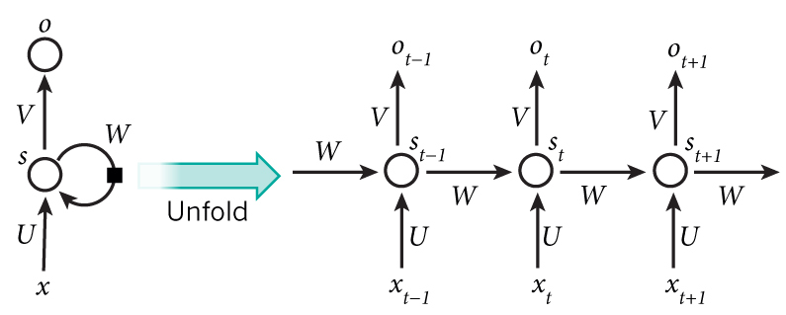
02
Attention and Transformers
3. RNN
Parameters to be learned:
U, V, W

Slide 9
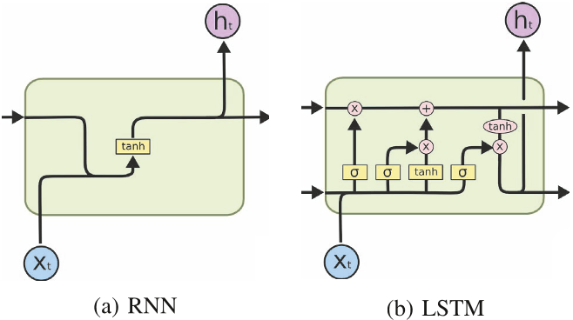
02
Attention and Transformers
Simple RNN vs LSTM

Slide 10
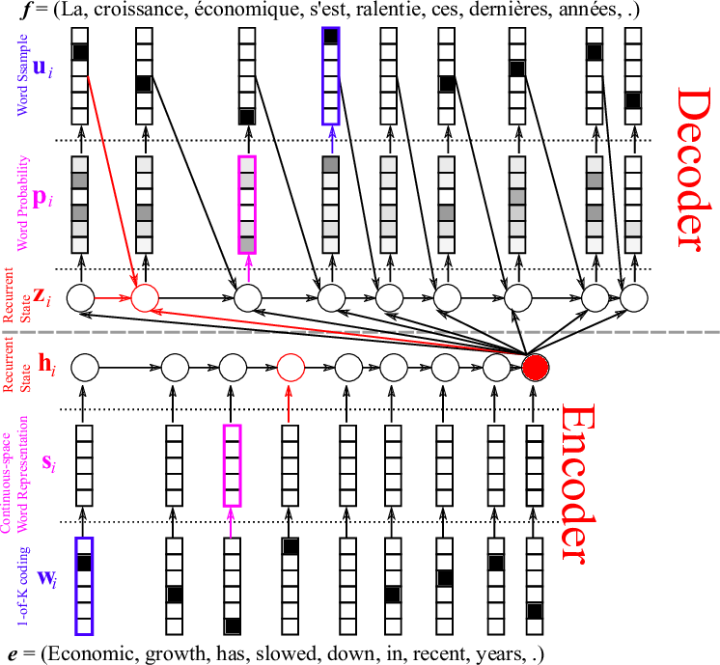
02
Attention and Transformers
Encoder-Decoder machine translation
LSTM

Slide 11
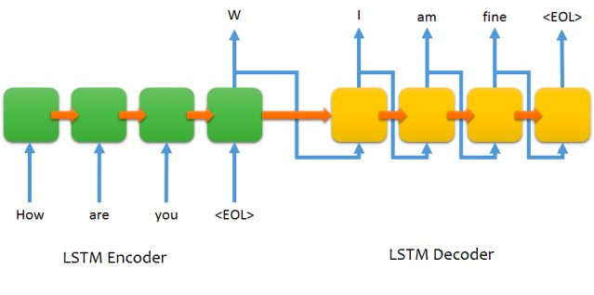
02
Attention and Transformers
Encoder-Decoder LSTM structure for chatting (for non-intelligent beings)

Slide 12
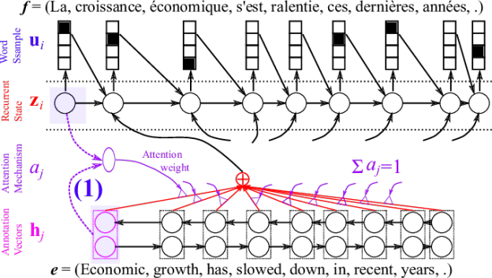
02
Attention and Transformers
Attention

Slide 13
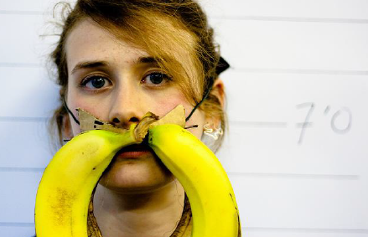
02
Attention and Transformers
Image caption generation using attention
A vector for each region
z⁰ is initial parameter, it is also learned
match
z⁰
0.7
CNN
filter
filter
filter
filter
filter
filter
filter
filter
filter
filter
filter
filter

Slide 14
02
Attention and Transformers
Image caption generation using attention
Word 1
A vector for each region
z⁰
z¹
Attention to
a region
weighted sum
CNN
filter
filter
filter
filter
filter
filter
0.7
0.1
0.1
0.1
0.0
0.0
filter
filter
filter
filter
filter
filter

Slide 15
02
Attention and Transformers
Image caption generation using attention
Word 1
Word 2
A vector for each region
z²
z⁰
z¹
weighted sum
CNN
filter
filter
filter
filter
filter
filter
0.0
0.8
0.2
0.0
0.0
0.0
filter
filter
filter
filter
filter
filter

Slide 16
02
Attention and Transformers
Image caption generation using attention
Kelvin Xu, Jimmy Ba, Ryan Kiros, Kyunghyun Cho, Aaron Courville, Ruslan Salakhutdinov, Richard Zemel, Yoshua Bengio,
“Show, Attend and Tell: Neural Image Caption Generation with Visual Attention”, ICML, 2015

Slide 17
02
Attention and Transformers
Many new ideas
ULM-FiT (Universal Language Model Fine-tuning for text classification), pre-training, transfer learning in NLP
Recurrent models require linear sequential computation, hard to parallelize. ELMo (Embeddings from Language Model), bidirectional LSTM.
In order to reduce such sequential computation, several models based on CNN are introduced, such as ConvS2S and ByteNet. Dependency for ConvS2S needs linear depth, and ByteNet logarithmic.
The transformer is the first transduction model relying entirely on self-attention to compute the representations of its input and output without using RNN or CNN.

Slide 18
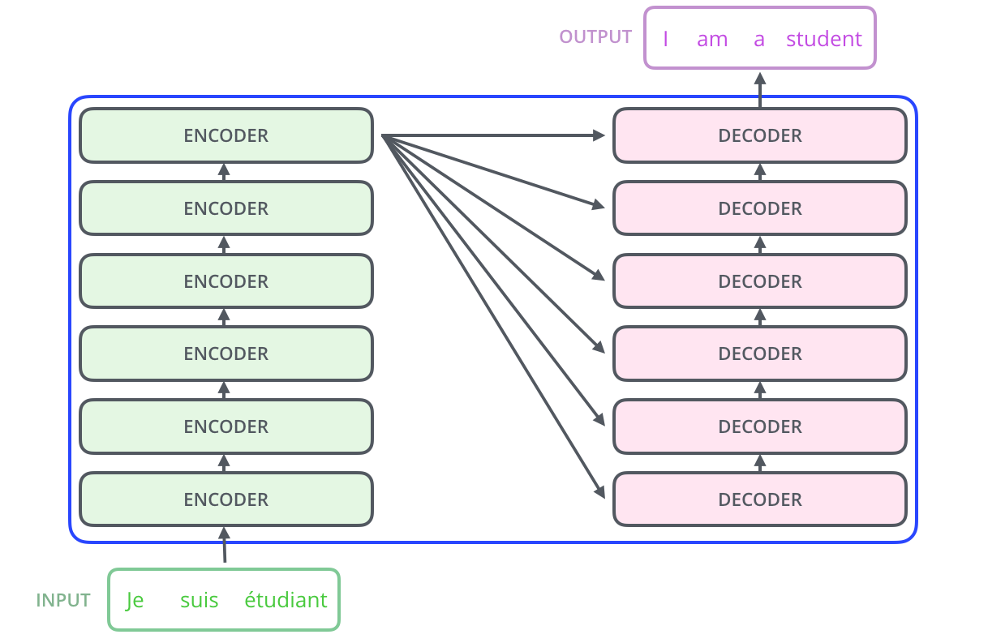
02
Attention and Transformers
Transformer

Slide 19
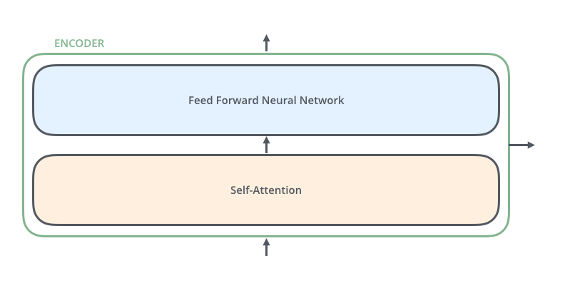
02
Attention and Transformers
An Encoder Block: same structure, different parameters

Slide 20
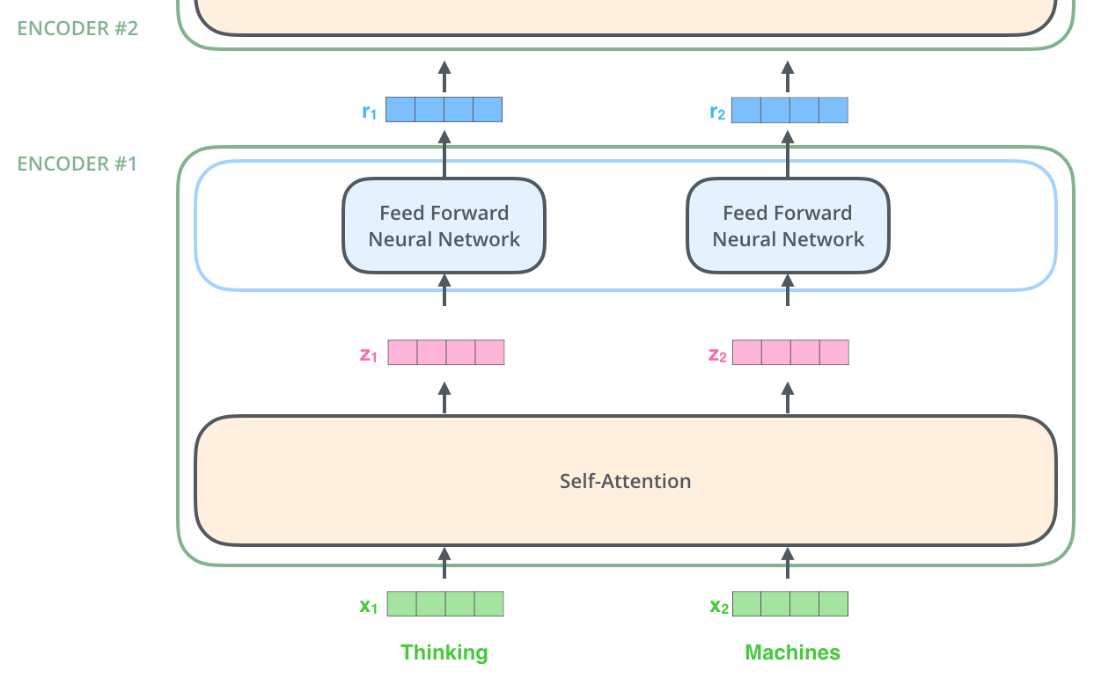
02
Attention and Transformers
Encoder
Note: The ffnn is independent
for each word.
Hence can be parallelized.

Slide 21
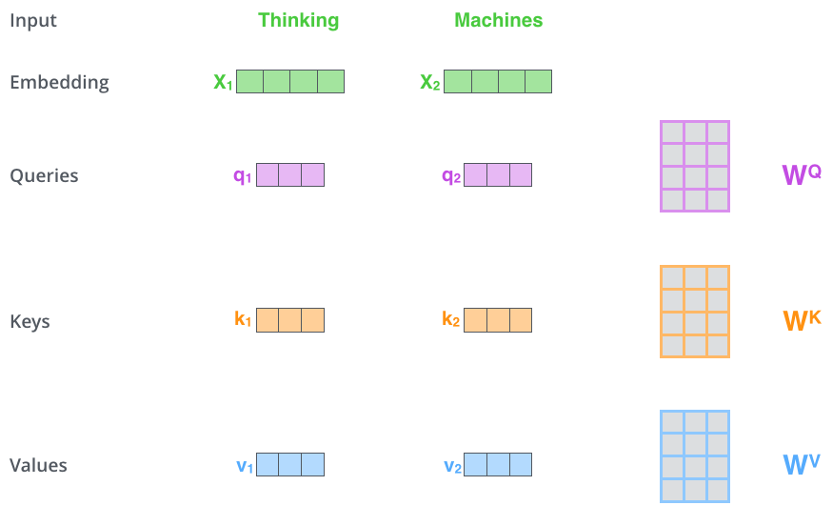
02
Attention and Transformers
Self Attention
First we create three vectors
by multiplying input embedding
(1x512) x_{i} with three matrices (64x512):
q_{i} = x_{i} W^{Q}
K_{i} = x_{i} W^{K}
V_{i} = x_{i} W^{V}
Notes:
Dimension of q,k,v

Slide 22
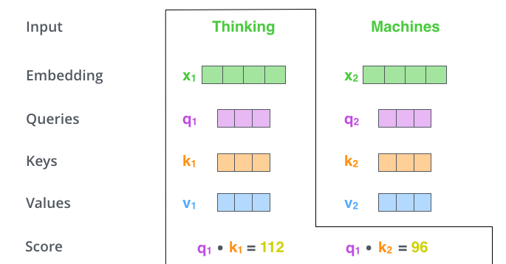
02
Attention and Transformers
Self Attention
Now we need to calculate
a score to determine how
much focus to place on other
Parts of the input.

Slide 23
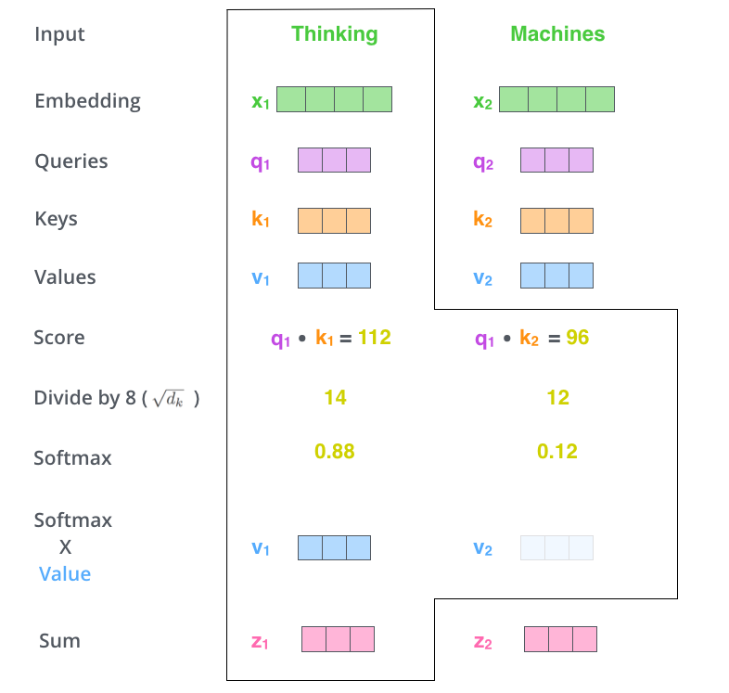
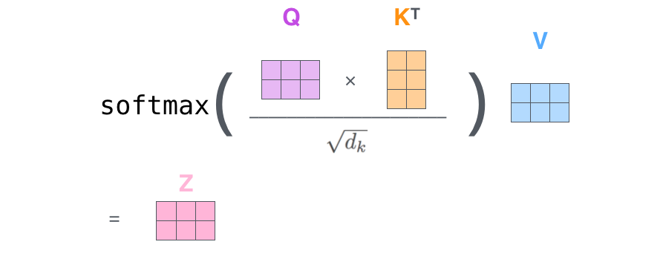
02
Attention and Transformers
Self Attention
Formula
~
~
d_{k}=64 is dimension of key vector
z₁= 0.88v₁+ 0.12v₂
Notes:
v~

Slide 24
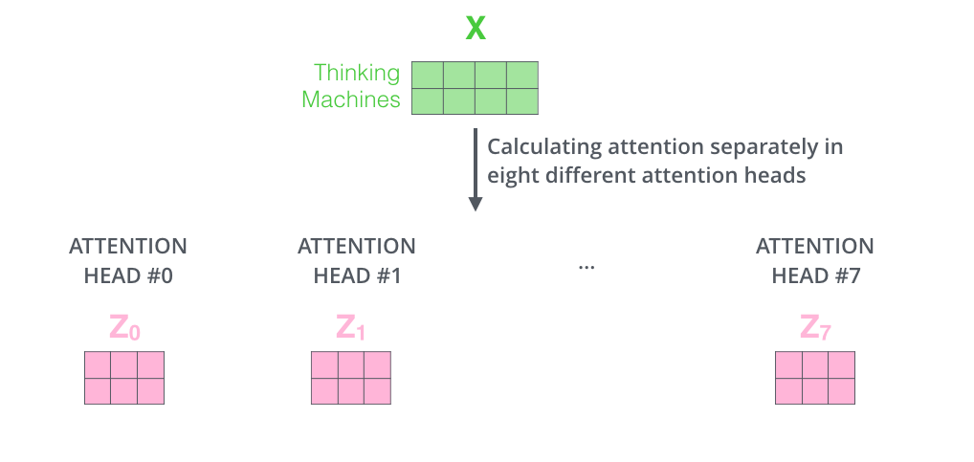
02
Attention and Transformers
Multiple heads
It expands the model’s ability to focus on different positions.
It gives the attention layer multiple “representation subspaces”

Slide 25
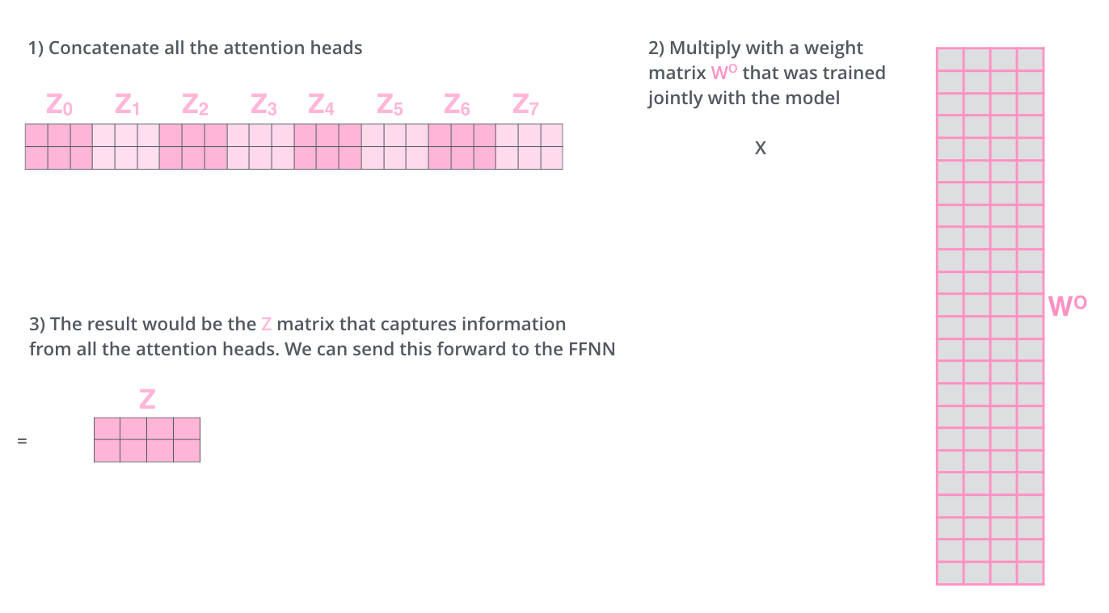
02
Attention and Transformers
The output is expecting only a 2x4
matrix, hence,
Notes:
What about order? What happens if scale of these vectors are out of proportion?

Slide 26
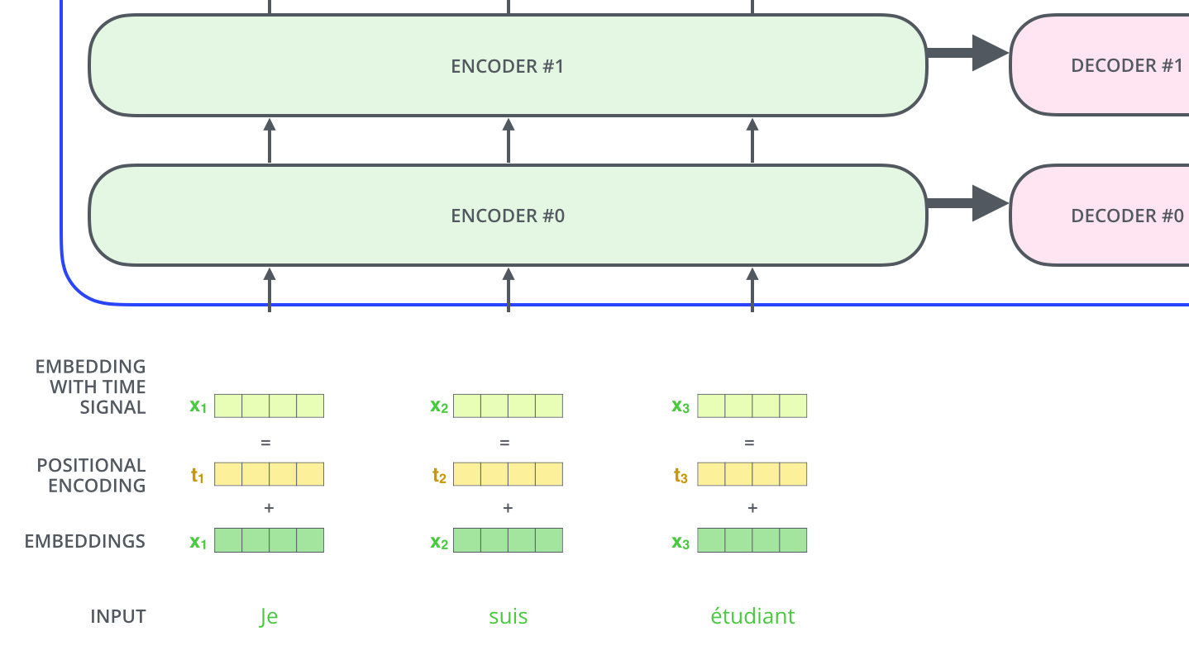
02
Attention and Transformers
Representing the input order (positional encoding)
The transformer adds a vector to each input embedding. These vectors follow a specific pattern that the model learns, which helps it determine the position of each word, or the distance between different words in the sequence. The intuition here is that adding these values to the embeddings provides meaningful distances between the embedding vectors once they’re projected into Q/K/V vectors and during dot-product attention.
positional encoding reference https://kazemnejad.com/blog/transformer_architecture_positional_encoding/

Slide 27
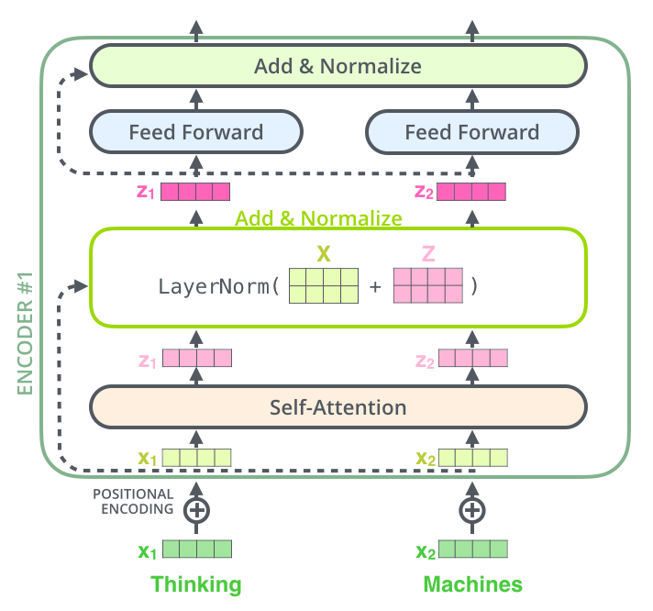
02
Attention and Transformers
Add and Normalize
In order to regulate the computation, this is a normalization layer so that each feature (column) have the same average and deviation.

Slide 28
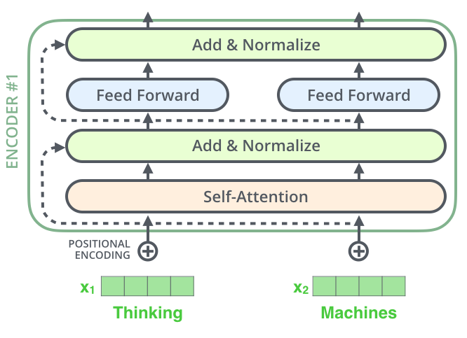
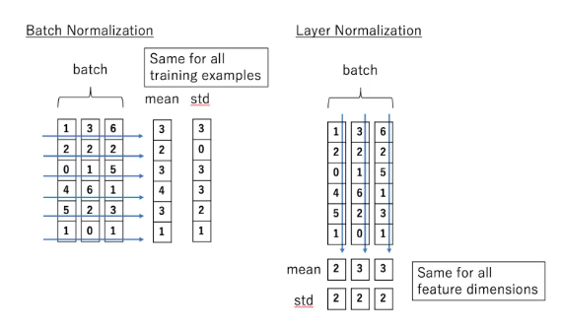
02
Attention and Transformers
Layer Normalization (Hinton)
Layer normalization normalizes the inputs across the features.

Slide 29
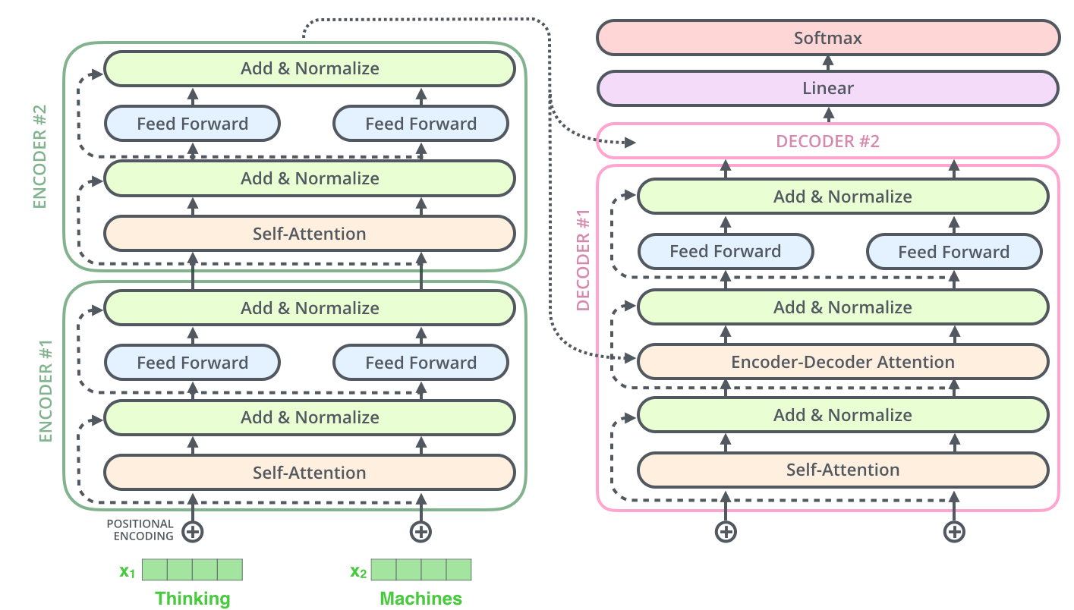
The complete transformer
02
Attention and Transformers
The encoder-decoder attention is just like self attention, except it uses K, V from the top of encoder output, and its own Q

Slide 30
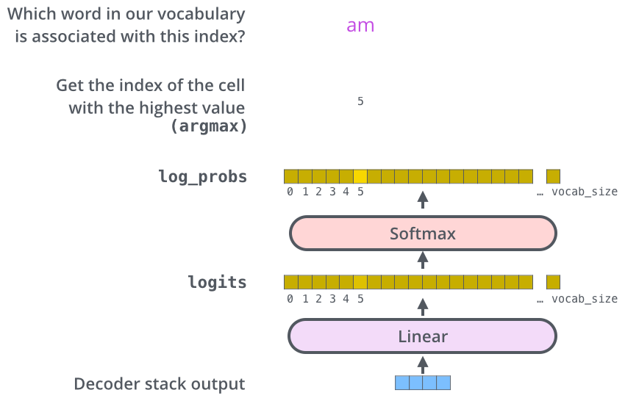
02
Attention and Transformers
Decoder’s
Output
Linear
Layer

Slide 31
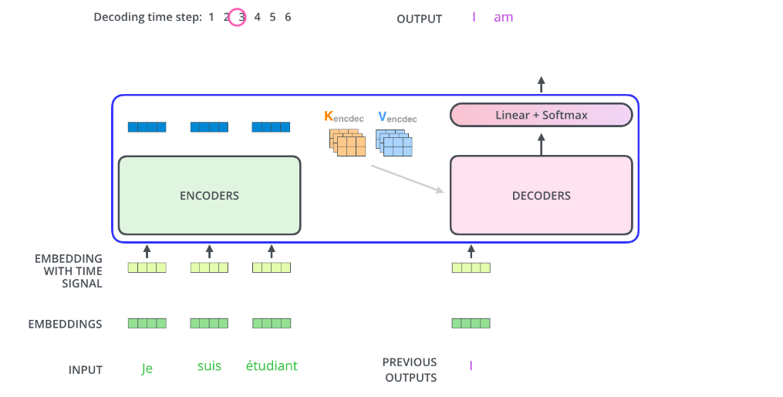
Attention and Transformers
How it works
02
Decoder’s
Output
Linear
Layer
But what about
Self-attention?

Slide 32
02
Attention and Transformers
But what about self-attention when the input is “incomplete”?
The solution is to set future unknown values with “-inf”.
The same for Encoder-Decoder Attention.

Slide 33
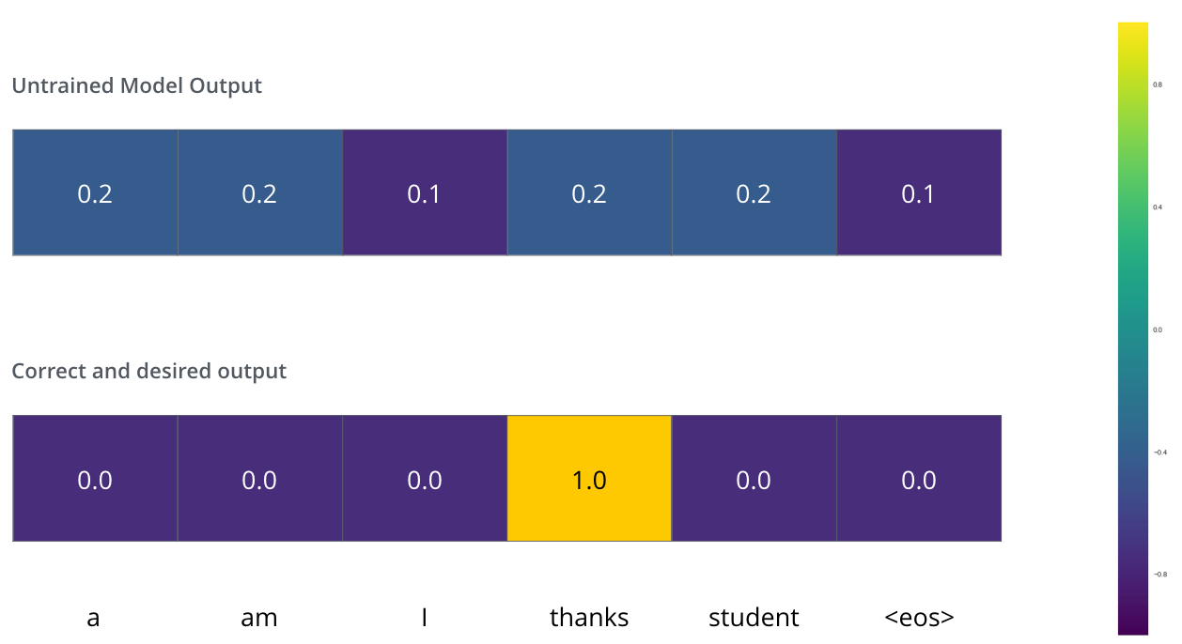
02
Attention and Transformers
Training and the Loss Function
We can use cross
Entropy.
We can also optimize two words at a time: using BEAM search: keep a few alternatives for the first word.

Slide 34
02
Attention and Transformers
Cross Entropy and KL (Kullback-Leibler) divergence
Entropy: E(P) = - Σ_{i}P(i)logP(i) - expected code length (also optimal)
Cross Entropy: C(P) = - Σ_{i}P(i) log Q(i) – expected coding
length using optimal code for Q
KL divergence:
D_{KL}(P || Q) = Σ_{i}P(i)log[P(i)/Q(i)] = Σ_{i}P(i)[logP(i) – logQ(i)], extra bits
JSD(P||Q) = ½ D_{KL}(P||M)+ ½ D_{KL}(Q||M), M= ½ (P+Q), symmetric KL
* JSD = Jensen-Shannon Divergency

Slide 35
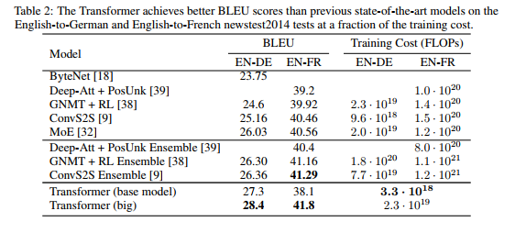
02
Attention and Transformers
Transformer Results

Slide 36
Next Lecture
02
Attention and Transformers
BERT
GPT

Slide 37
02
Attention and Transformers
Literature & Resources for Transformers
Vaswani et al. Attention is all you need. 2017.
Resources:
https://nlp.seas.harvard.edu/2018/04/03/attention.html (Excellent explanation of transformer model with codes.)
Jay Alammar, The illustrated transformer (from which I borrowed many pictures):
http://jalammar.github.io/illustrated-transformer/
Kate Logninova: Attention in NLP, summarizes all sorts of attentions. Can somebody present this and related literature? https://medium.com/@joealato/attention-in-nlp-734c6fa9d983
Notes:
https://zhuanlan.zhihu.com/p/48508221

Slide 38
Thank You!

